Slide 1
XAI Methods Categorization
Raghu Prasad
9845547471
www.kaushalya.tech
CEO

Slide 2
Introduction
Raghu Prasad – BE, MS
Total of 30 years of experience
7 years as a lecturer in an Engineering College
23 Years into IT
Worked with companies like CISCO,CSC,ICICI,First Apex – NTT Data
Currently into Corporate training and consultancy
Worked with corporates and public sector
Service Offerings – In person/On-line/Corporate/Academic Institutes
Consultancy – Consultant to vendor of Atal Tinkering Lab/ECIL-ECIT, Incarnus – Healthcare Service Provider
Technologies – Java,Python,Web technologies,Java Script technologies (MEAN stack),IOT,Test Automation,Machine Learning,Artificial Intelligence,ERP,.NET,Cloud Computing,Devops,MLOps
Customers – ILinkDigital,Operative,Flatworld,IQVIA,Sony,Philips,L & T,NextGen,Incarnus,Aspire system,
NewHorizonCollege Of Engineering,NIE Mysore,Acharya College Of Engineering,SIT-Tumakuru,BGS-IT,Sindhi College,Malnad Enginering College,S B College of Management, REVA University,Nagarjuna Engineering College,Dayanand Sagar University,NIT-Imphal

Slide 3
Topics
XAI Methods

Slide 4
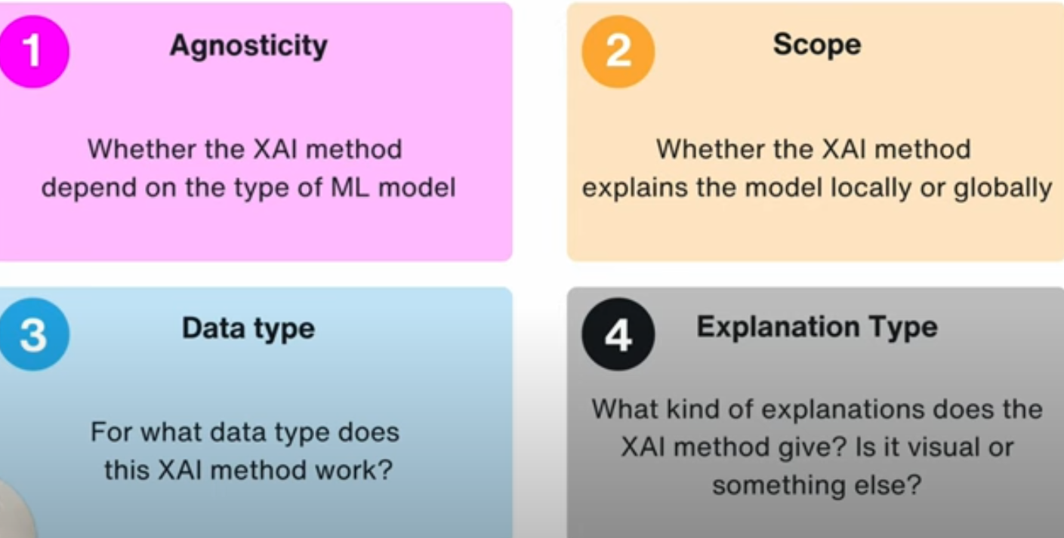
XAI Methods Categorization
Notes:
Transparency – making decision in self driving car,finance.. Healthy or unhealth.. Which factors making as unhealty.. Conducting a surgery..Why surgery is prescribed.

Slide 5
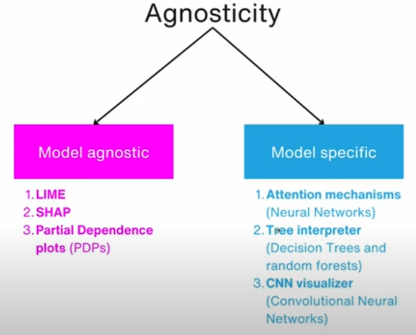
XAI Methods Categorization
Notes:
Transparency – making decision in self driving car,finance.. Healthy or unhealth.. Which factors making as unhealty.. Conducting a surgery..Why surgery is prescribed.

Slide 6
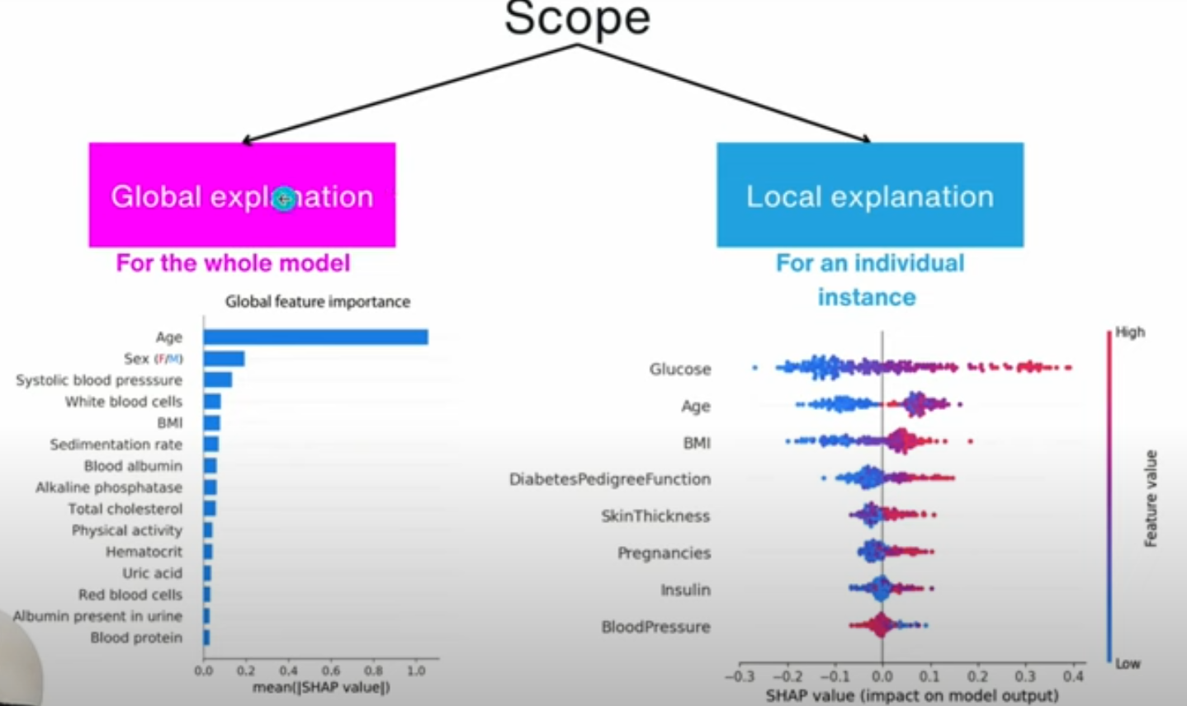
XAI Methods Categorization
Notes:
Transparency – making decision in self driving car,finance.. Healthy or unhealth.. Which factors making as unhealty.. Conducting a surgery..Why surgery is prescribed.

Slide 7
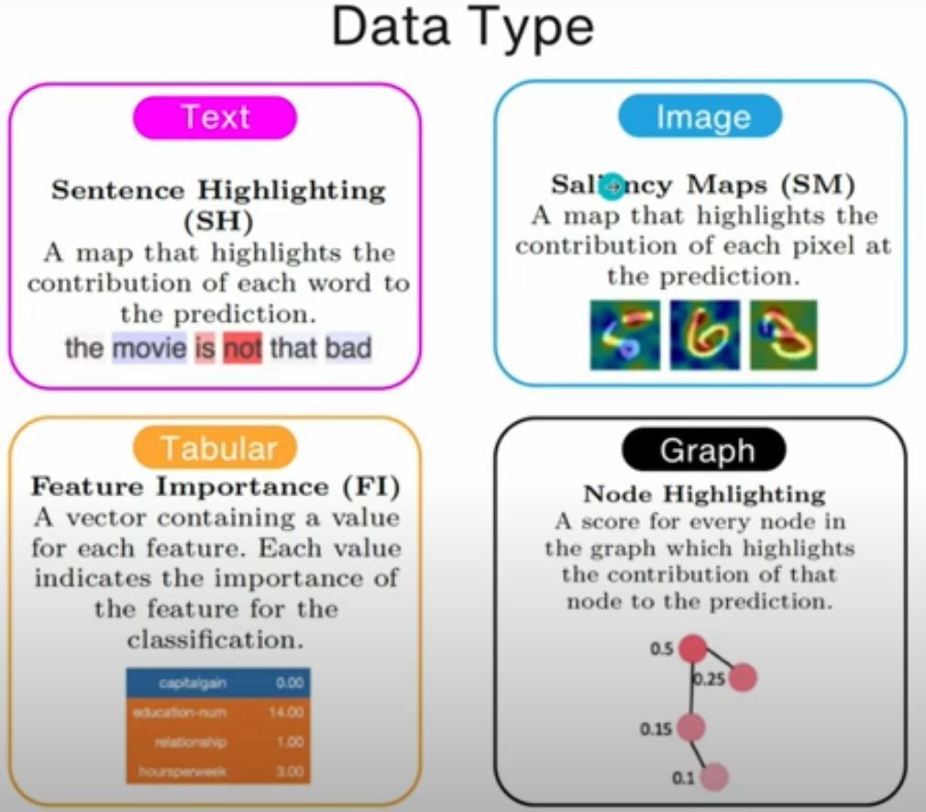
XAI Methods Categorization
Notes:
Transparency – making decision in self driving car,finance.. Healthy or unhealth.. Which factors making as unhealty.. Conducting a surgery..Why surgery is prescribed.

Slide 8
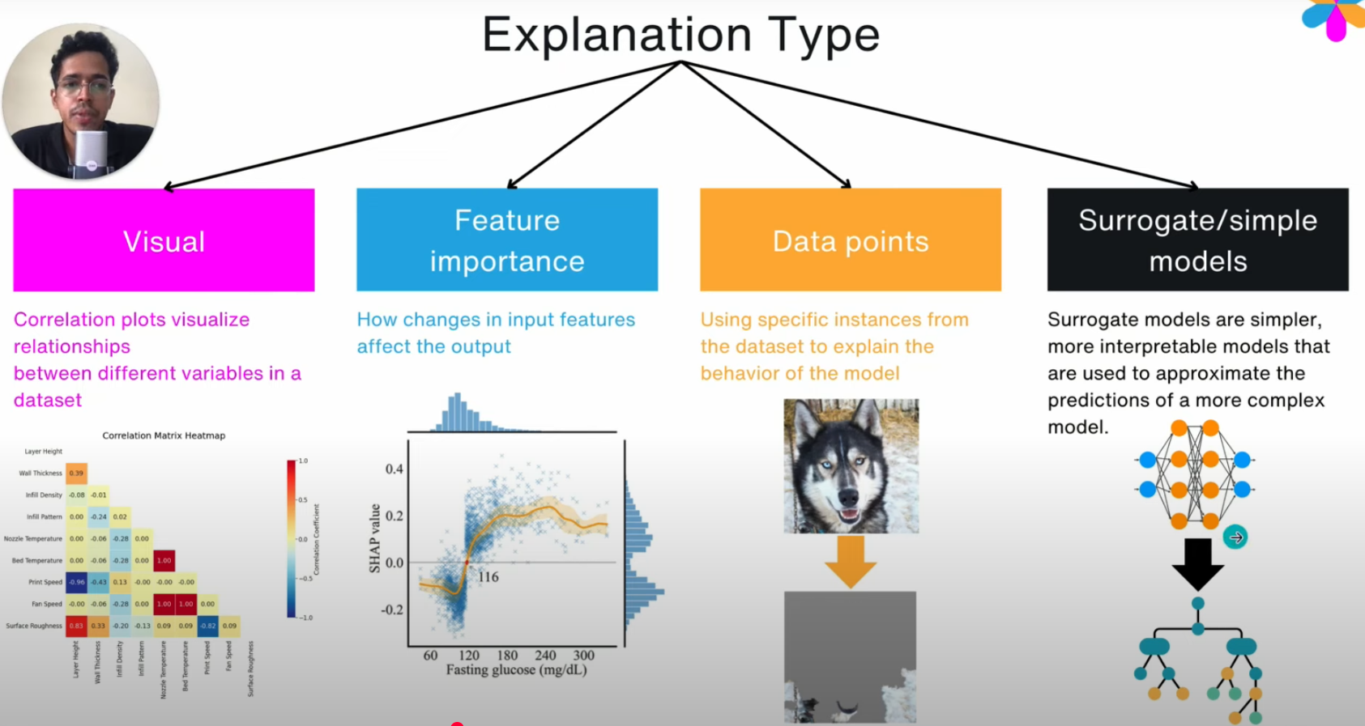
XAI Methods Categorization
Notes:
Transparency – making decision in self driving car,finance.. Healthy or unhealth.. Which factors making as unhealty.. Conducting a surgery..Why surgery is prescribed.

Slide 9
XAI Methods Categorization
Notes:
Transparency – making decision in self driving car,finance.. Healthy or unhealth.. Which factors making as unhealty.. Conducting a surgery..Why surgery is prescribed.

Slide 10
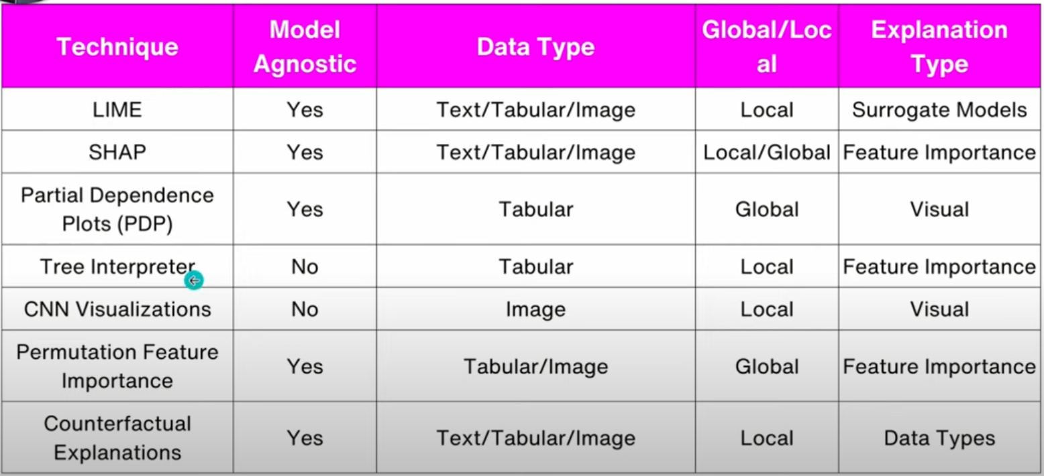
XAI Techniques
Notes:
Transparency – making decision in self driving car,finance.. Healthy or unhealth.. Which factors making as unhealty.. Conducting a surgery..Why surgery is prescribed.

Slide 11
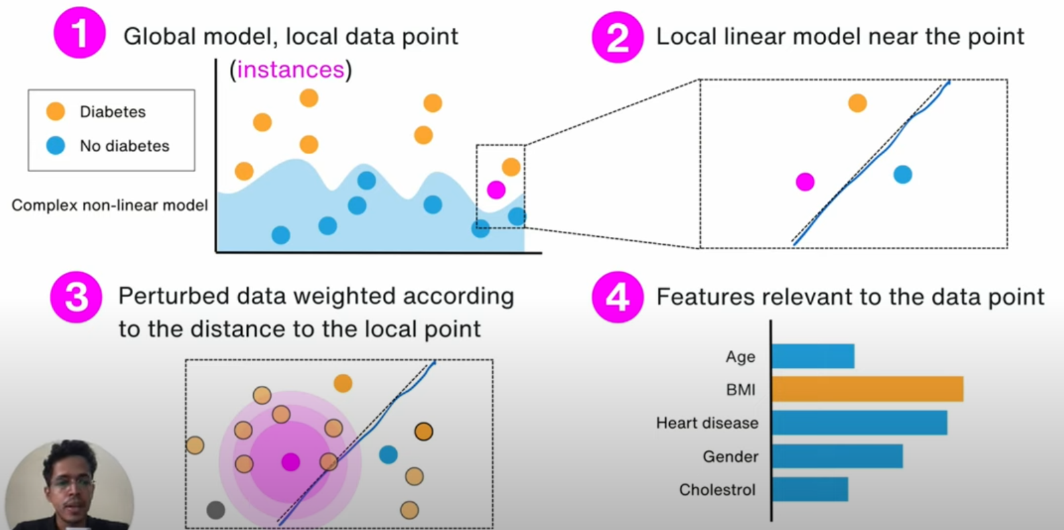
LIME(Local Interpretable Model Agnostic Explanations)
Notes:
Transparency – making decision in self driving car,finance.. Healthy or unhealth.. Which factors making as unhealty.. Conducting a surgery..Why surgery is prescribed.

Slide 12
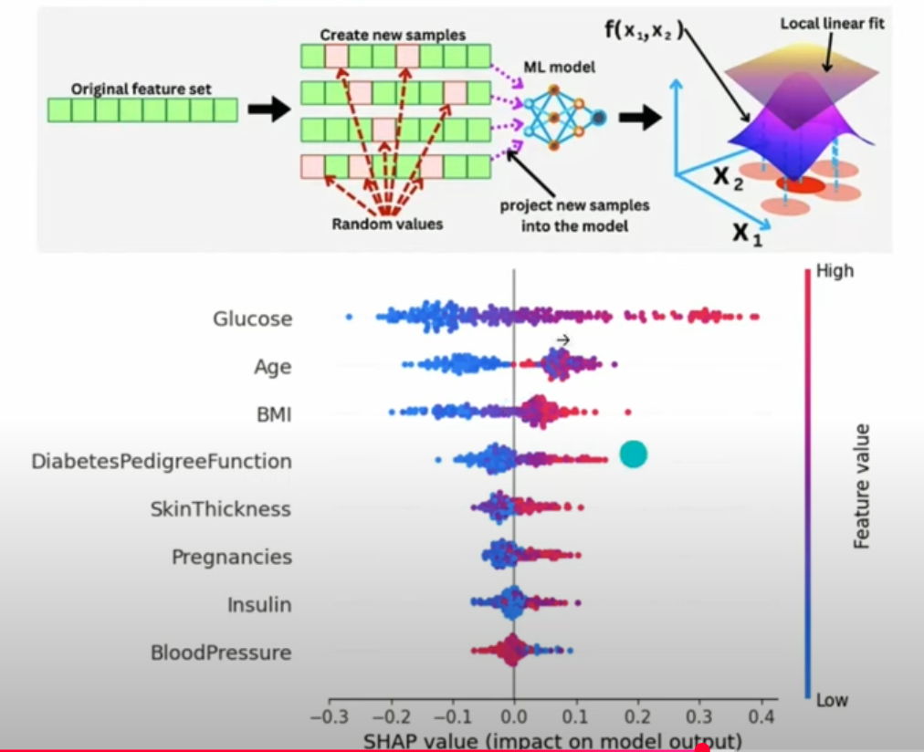
SHAP(Shapley Additive exPlanations)
Notes:
Transparency – making decision in self driving car,finance.. Healthy or unhealth.. Which factors making as unhealty.. Conducting a surgery..Why surgery is prescribed.

Slide 13
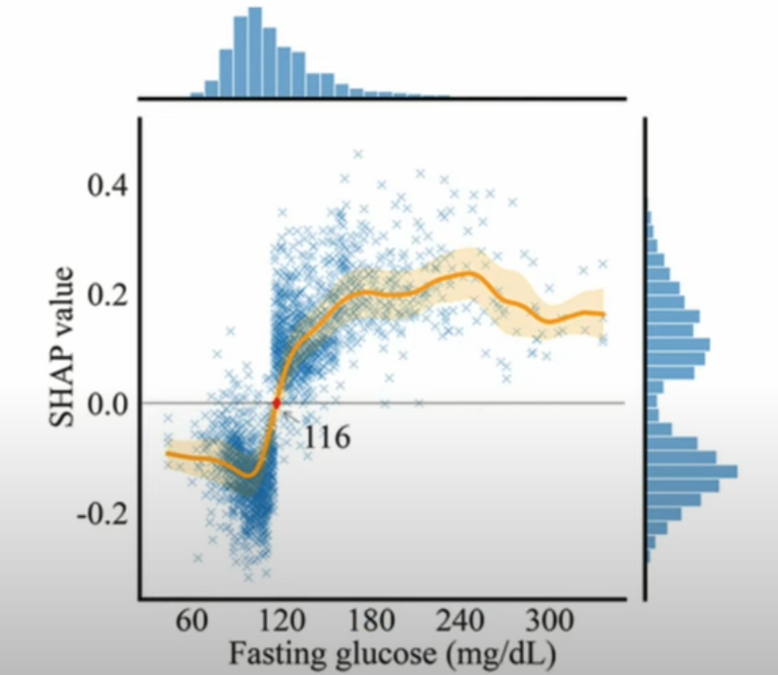
Partial Dependence Plots
Notes:
Transparency – making decision in self driving car,finance.. Healthy or unhealth.. Which factors making as unhealty.. Conducting a surgery..Why surgery is prescribed.

Slide 14
References
Referred papers: Interpreting Black‑Box Models: A Review on Explainable Artificial Intelligence: https://link.springer.com/article/10.... Explainable artificial intelligence: an analytical review: https://wires.onlinelibrary.wiley.com... Benchmarking and survey of explanation methods for black box models: https://link.springer.com/article/10.... "Why Should I Trust You?": Explaining the Predictions of Any Classifier https://arxiv.org/pdf/1602.04938
Notes:
Linear Regression is highly interpretable

Slide 15
Thank You
Raghu Prasad
9845547471
www.kaushalya.tech

